Slide 1
Cloud Native Applications
using Spring Cloud Netflix
Jacek Bukowski
Consultant Engineering
JUG Zielona Góra 30.11.2016

Slide 2
Joint forces of Netflix and Spring
Spring was always about simplifying the complicated aspects of your enterprise system. Netflix went to microservice architecture long before this term even was created. Both are very much contributed to open source software. How can you benefit from joint forces of the both?

Slide 3
Cloud and Cloud Native Application

Slide 4
Cloud
any computing environment in which computing, networking, and storage resources can be provisioned and released elastically in an on-demand, self-service manner
from „Migrating to Cloud Native Applications Architectures” by Matt Stine

Slide 5




Target cloud
Service model
Cloud Provider
SaaS
PaaS
IaaS
MBaaS
EaaS
XaaS
*aaS

Slide 6

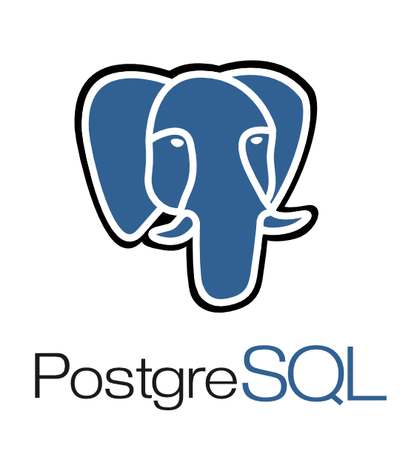

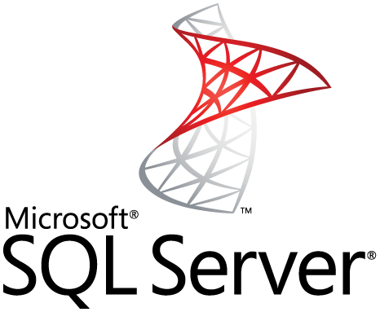






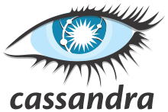


Technology stack
Language
Persistence

Slide 7

Cloud Native
Style of application development
Characteristics
Twelve-Factor Applications – http://12factor.net
Microservices
Self-Service Agile Infrastructure
API-Based Collaboration
Antifragility
Cultural & Organizational changes
Notes:
Twelve-Factor Applications - a collection of patterns for SaaS application architectures, originally developed by engineers at Heroku.
Codebase
Dependencies
Config
Backing services
Build, release, run
Processes
Port binding
Concurrency
Disposability
Dev/prod parity
Logs
Admin processes
Migration cookbook:
Patterns/recipes – shown later
Decomposition recipes

Slide 8

The Twelve-Factor App (from 12factor.net)
Codebase
One codebase tracked in revision control, many deploys
Dependencies
Explicitly declare and isolate dependencies
Config
Store config in the environment
Backing services
Treat backing services as attached resources
Build, release, run
Strictly separate build and run stages
Processes
Execute the app as one or more stateless processes
Port binding
Export services via port binding
Concurrency
Scale out via the process model
Disposability
Maximize robustness with fast startup and graceful shutdown
Dev/prod parity
Keep development, staging, and production as similar as possible
Logs
Treat logs as event streams
Admin processes
Run admin/management tasks as one-off processes

Slide 9
Cloud Native
Style of application development
Characteristics
Twelve-Factor Applications – http://12factor.net
Microservices
Self-Service Agile Infrastructure
API-Based Collaboration
Antifragility
Cultural & Organizational changes
Notes:
Twelve-Factor Applications - a collection of patterns for SaaS application architectures, originally developed by engineers at Heroku.
Codebase
Dependencies
Config
Backing services
Build, release, run
Processes
Port binding
Concurrency
Disposability
Dev/prod parity
Logs
Admin processes
Migration cookbook:
Patterns/recipes – shown later
Decomposition recipes

Slide 10
Netflix

Slide 11
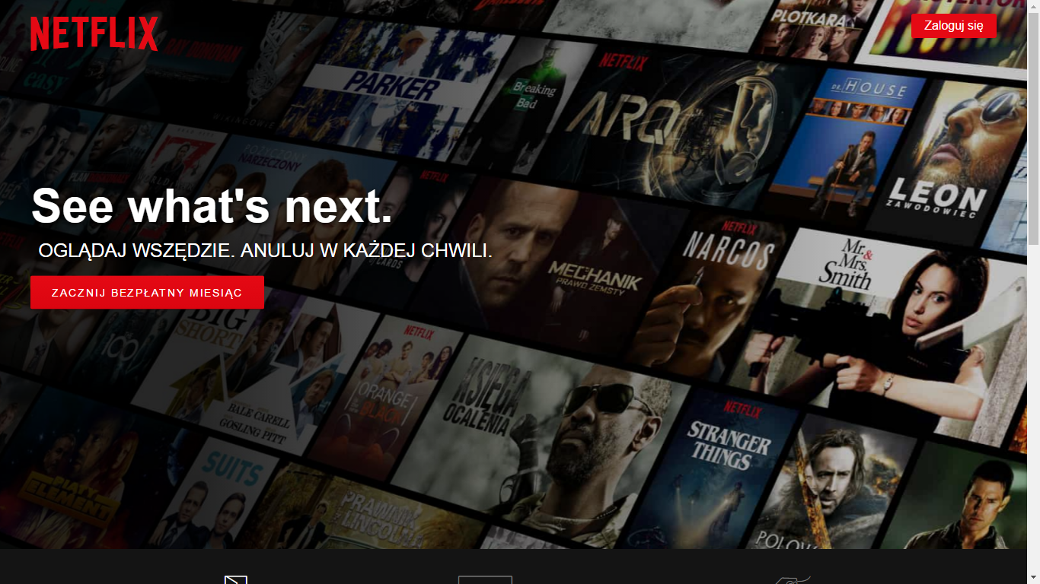
Netflix – some facts
Moved away of monolithic architecture before microservices where named (started in 2009, ended early 2016)
30% of the Internet traffic
500+ microservices
2+ billion API gateway requests daily
Each API call requires avarage six calls to backend services
Over 800 different client devices
Open sourced much of their tools and services
Notes:
Netflix starter moving out of the monolithic architecture in 2009, while term „microservice” showed up in 2012 – one of the first was James Lewis during 33rd Degree conference in Kraków

Slide 12
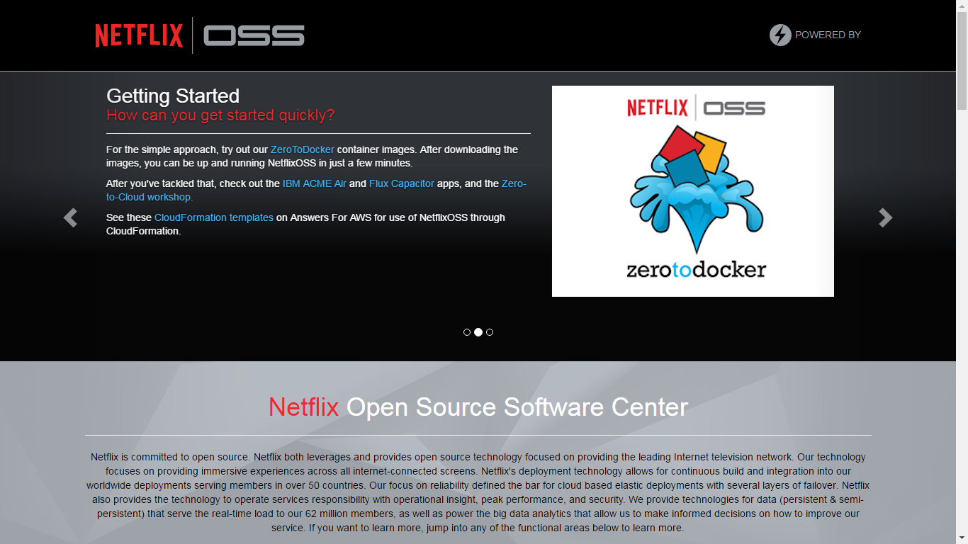
Netflix Open Source Software (OSS)
Netflix provides the Open Source Software Center: http://netflix.github.io/
Big Data
Build and Delivery Tools
Common Runtime Services & Libraries
Content Encoding
Data Persistence
Insight, Reliability and Performance
Security
User Interface
Notes:
Big data - Tools and services to handle (big) data
Build and Delivery Tools – get software from desktop to the cloud
Common Runtime Services & Libraries - Runtime containers, libraries and services that power microservices
Content Encoding - automated scalable multimedia ingest and encoding
Data Persistence - storing and serving data in the Cloud
Insight, Reliability and Performance – metrics and performance analysis
Security – tools to analyse and monitor security data
User Interface - Libraries to help you build rich client applications

Slide 13
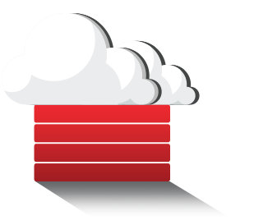
Netflix Open Source Software (OSS)
Runtime and Libraries
Eureka – registry/service discovery
Archaius – distributed configuration
Ribbon – inter process and service communication
Hystrix – reliability of calls and fault tolerance
Karyon and Governator – containers
Prana – support for non-JVM runtimes
Zuul – dynamic routing, monitoring, resiliency and security, used to handle front end requests
Fenzo – scheduler for Apache Mesos

Slide 14
Spring Cloud

Slide 15

Spring Cloud
Facilitates the Cloud Native styles
Common features required by all the components in a distributed system
Distributed/versioned configuration
Service registration and discovery
Routing
Service-to-service calls
Load balancing
Circuit Breakers
Global locks
Leadership election and cluster state
Distributed messaging

Slide 16


Spring Cloud
Spring Cloud for Cloud Foundry
Spring Cloud for Amazon Web Services
Spring Cloud Bus
Spring Cloud ...
Spring Cloud Config
Spring Cloud Netfix
Spring Cloud Consul
Spring Cloud Context
Spring Cloud Commons
Spring Boot
Spring

Slide 17
Spring Boot Context
Bootstrap Context
Higher precedence
External properties
(e.g. Config Server)
Parent of Main Application Context
Used to load properties from external sources
Out of the box loads properties form Config Server
Can be configured to do anything you want
Handling environment changes
Re-bind @ConfigurationProperties
Set log levels for logging.level.*
@RefreshScope
Environment
Main Applicatin Context
application.yml
application-{profile}.yml
bootstrap.yml
bootstrap-{profile}.yml
Bootstrap
Context

Slide 18
Spring Cloud Config
Config Server
Config Client
HTTP, resource-based API for external configuration
JSON/YML/properties resources
Git backend (default)
Integrates with Spring Security
Config-first bootstrap
Discovery-first bootstrap
Fail-fast option
Like reading local application*.yml family with extra dimention „label”
/{application}/{profile}[/{label}]
/{application}-{profile}.yml
/{label}/{application}-{profile}.yml
/{application}-{profile}.properties
/{label}/{application}-{profile}.properties
${spring.application.name}
${spring.profiles.active}
master
/{application}/{profile}/{label}
spring.cloud.config.[name|env|label]

Slide 19


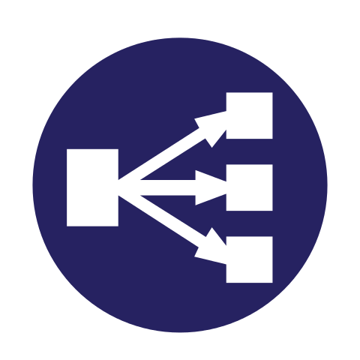
Spring Cloud Commons
Common Abstractions
Service Discovery
Load Balancing
Circuit Breakers
Implementations:
Spring Cloud Netflix
Spring Cloud Consule

Slide 20

Spring Cloud Netflix
Enable common patterns with just annotations:
Discovery: Eureka
Circuit Breaker: Hystrix
Client Side Load Balancer: Ribbon
Declarative REST Client: Feign
Router and Filter: Zuul
External Configuration: Archaius

Slide 21

Discovery: Eureka
Eureka Server
Eureka Client
Run by @EnableEurekaServer
By default is also a client, so needs a peer
Optional standalone mode
Keep registration in memory
Enable by @EnableDiscoveryClient or @EnableEurekaClient
Sending heartbeats to Eureka server
Optionally send full health check status
Special virutal URL: http://users/...
Discovery clients:
Native EurekaClient
Spring Cloud DiscoveryClient
Feign client
Spring RestTemplate

Slide 22
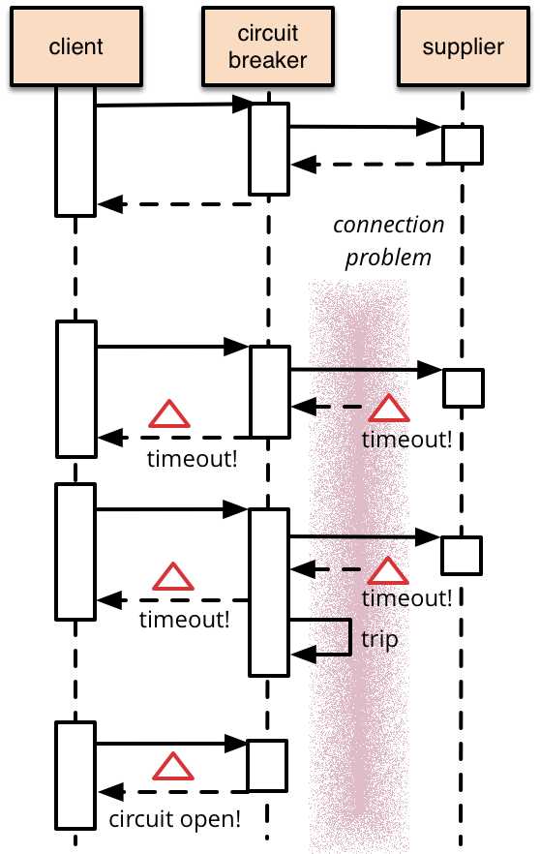

Circuit Breaker: Hystrix
Proxy the beans enabling circuit breaker
Enabled by annotation on the method
@HystrixCommand(fallbackMethod=„”)
public Article getArticle(String id) { // call external system
}
Fallback can be provided
Hystrix metrics stream: /hystrix.stream
Hystrix Dashboard
Turbine combining hystrix streams

Slide 23
Client side load balancer: Ribbon
Used by default in @FeignClient
Ribbon API can be used directly
Configuring by <client>.ribbon.listOfServers
Can get „listOfServers” from Eureka, if available

Slide 24
Feign Client
Declarative Web Service Client
Create interface and annotate it
Feign annotations, JAX-RS annotations, Spring MVC (added by Spring Cloud)
@FeignClient(name = "articles-service")
public interface ArticlesClient {
@RequestMapping(value = "/articles/{id}", method = RequestMethod.GET, produces = MediaType.APPLICATION_JSON_VALUE)
public Article getArticle(@PathVariable("id") String id);
}
In Spring Cloud uses Eureka, Ribbon and Hystrix

Slide 25
Demo

Slide 26
1 class
Git
Registry Server
(Eureka)
YAML files
Config Server
1 class
find Articles Service
4 classes
Articles Service
Articles Service
get properties – default number of articles
News Service
Get article content
5 classes
Load balanced
Protected with Circuit Breaker
Give me news!
Client

Slide 27
Questions

Slide 28
Thank you
Github: https://github.com/buczyn/spring-cloud-netflix-demo
Jacek Bukowski
Consultant Engineering
jacek.bukowski@globallogic.com
+48 728 869 133

